Slide 1


OBJECT-ORIENTED ANALYSIS AND DESIGN WITH UML 2.0
Bé m«n C«ng nghÖ phÇn mÒm
KHOA CÔNG NGHỆ THÔNG TIN
TRƯỜNG ĐẠI HỌC BÁCH KHOA HÀ NỘI
Bài 8. Thiết kế lớp
Nguyễn Thị Thu Trang
trangntt-fit@mail.hut.edu.vn

Slide 2
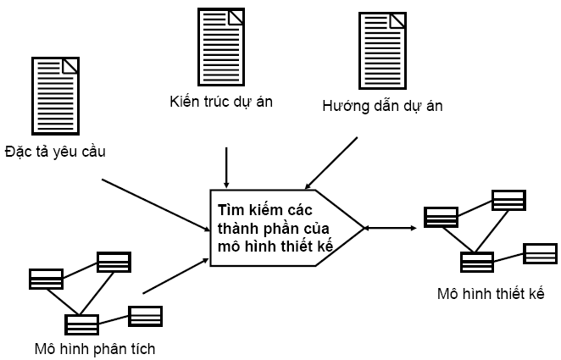
Mô hình thiết kế

Slide 3
Nội dung
Xác định các thao tác (Operation)
Xác định phương thức (Method)
Xác định các liên kết (Association)
Xác định các thuộc tính (Attribute)
Xác định phụ thuộc (Dependency)
Xác định tổng quát hóa (Generalization)

Slide 4
1. Xác định các thao tác
Ánh xạ các thông điệp trong biểu đồ tương tác thành các thao tác của các lớp
: ClassA
: ClassB
ClassB
1 : performResponsibility (): result
+ performResponsibility(): result
Notes:
Emphasize how operations and attributes are domain dependent. As a quick in-class exercise: Pick a class, pick two different domains, pick two students, one for each domain, and have them choose relevant operations and attributes for the class.
Stress that because the process is use-case-driven, all discovered operations and attributes should support at least one use case. Thus, the attributes/operations that are discovered are affected by what functionality/domain you are modeling.
While discussing where to find operations, it is worth exploring with which object an operation belongs. You will find that the operation always goes in the supplier object. On the interaction diagram, the client is initiating a request from the supplier, so the supplier object/class has the operation. Some people, especially people used to functional decomposition, get this confused initially.
To identify operations on design classes:
Study the responsibilities of each corresponding analysis class, creating an operation for each responsibility. Use the description of the responsibility as the initial description of the operation.
Study the Use-Case Realizations in the class participations to see how the operations are used by the Use-Case Realizations. Extend the operations, one Use-Case Realization at a time, refining the operations, their descriptions, return types and parameters. Each Use-Case Realization's requirements, as regards classes, are textually described in the Flow of Events of the Use-Case Realization.
Study the use-case Special Requirements, to make sure that you do not miss implicit requirements on the operation that might be stated there.
Use-Case Realizations cannot provide enough information to identify all operations. To find the remaining operations, consider the following:
Is there a way to initialize a new instance of the class, including connecting it to instances of other classes to which it is associated?
Is there a need to test to see if two instances of the class are equivalent?
Is there a need to create a copy of a class instance?
Are any operations required on the class by mechanisms which they use? (Example: a “garbage collection” mechanism may require that an object be able to drop all of its references to all other objects in order for unused resources to be freed.)

Slide 5
Tên và mô tả thao tác
Tạo ra các tên thao tác thích hợp
  Mô tả kết quả
  Sử dụng góc nhìn của đối tượng khách (gọi)
  Nhất quán giữa các lớp
Xác định chữ ký của thao tác
  operationName([direction]parameter : class,..) : returnType
    Direction: in (mặc định), out hoặc inout
Đưa ra mô tả ngắn gọn, bao gồm ý nghĩa của tất cả các tham số
Notes:
You can foreshadow a discussion of polymorphism here. Operations across classes that have the same signature and semantics should return the same type of result and have the same name, even if their implementation is different in each class.
Operations should be named to indicate their outcome. For example, getBalance() versus calculateBalance(). One approach for naming operations that get and set properties is to simply name the operation the same name as the property. If there is a parameter, it sets the property; if not, it returns the current value.
You should name operations from the perspective of the client asking for a service to be performed by the class. For example, getBalance() versus receiveBalance(). The same applies to the operation descriptions. Descriptions should always be written from the operation USER’s perspective. What service does the operation provide?
It is best to specify the operations and their parameters using implementation language syntax and semantics. This way the interfaces will already be specified in terms of the implementation language when coding starts.

Slide 6
Hướng dẫn thiết kế chữ ký thao tác
Khi thiết kế chữ ký của thao tác, cần xem xét liệu tham số có:
  Được truyền theo tham trị hay tham biến
  Có bị thay đổi bởi thao tác hay không
  Có tùy chọn không
  Thiết lập các giá trị mặc định
  Các khoảng tham số không hợp lệ
Càng ít tham số, càng tốt
Truyền các đối tượng thay vì hàng loạt các dữ liệu.
Notes:
In addition to the short description of the parameter, be sure to include things like:
Whether the parameter should be passed by value or by reference, and if by reference, is the parameter changed by the operation? By value means that the actual object is passed. By reference means that a pointer or reference to the object is passed.
The signature of the operation defines the interface to objects of that class, and the parameters should therefore be designed to promote and define what that interface is. For example, if a parameter should never be changed by the operation, then design it so that it is not possible to change it — if the implementation environment supports that type of design.
Whether parameters may be optional and/or have default values when no value is provided.
Whether the parameter has ranges of valid values.
The fewer parameters you have, the better. Fewer parameters help to promote understandability, as well as maintainability. The more parameters clients need to understand, the more tightly coupled the objects are likely to be conceptually.
One of the strengths of OO is that you can manipulate very rich data structures, complete with associated behavior. Rather than pass around individual data fields (for example, StudentID), strive to pass around the actual object (for example, Student). Then the recipient has access to all the properties and behavior of that object.

Slide 7
Phạm vi truy cập của thao tác (Operation Visibility)
Phạm vi truy cập được sử dụng để thực hiện khả năng đóng gói
Có thể là public, protected, hoặc private
Private
operations
Public operations
Protected
operations
Notes:
Re-emphasize that you must define a good abstraction — you must think about what operations are public and private and you must think about encapsulation.
Operation visibility is the realization of the key object-orientation principle of encapsulation.
Public members are accessible directly by any client.
Protected members are directly accessible only by instances of subclasses.
Private members are directly accessible only by instances of the class to which they are defined.
How do you decide what visibility to use? Look at the Interaction diagrams on which the operation is referenced. If the message is from outside of the object, use public. If it is from a subclass, use protected. If it’s from itself, use private. You should define the most restrictive visibility possible that will still accomplish the objectives of the class. Client access should be granted explicitly by the class and not taken forcibly.
Visibility applies to attributes as well as operations. Attributes are discussed later in this module.

Slide 8
Phạm vi truy cập được biểu diễn như thế nào?
Các ký hiệu sau được sử dụng:
  + Public access
  # Protected access
  - Private access
Class1
- privateAttribute
+ publicAttribute
# protectedAttribute
- privateOperation ()
+ publicOPeration ()
# protecteOperation ()
Notes:
Note that the UML Notation Guide explicitly states, “A tool may show the visibility indication in a different way, such as by using a special icon.” So, the usage of the graphical icons for export control is valid UML.
In the UML, you can specify the access clients have to attributes and operations.
Export control is specified for attributes and operations by preceding the name of the member with the following symbols:
+ Public
# Protected
- Private

Slide 9
Phạm vi (Scope)
Xác định số lượng thể hiện của thuộc tính/thao tác:
  Instance: Một thể hiện cho mỗi thể hiện của mỗi lớp
  Classifier: Một thể hiện cho tất cả các thể hiện của lớp
Phạm vi Classifier được ký hiệu bằng cách gạch dưới tên thuộc tính/thao tác.
Class1
- classifierScopeAttr
- instanceScopeAttr
+ classifierScopeOp ()
+ instanceScopeOp ()
Notes:
You cannot underline the class scope operation and attribute names, but you can use an attribute and operation stereotype (for example, <<class>>) to denote class scope attributes and operations on a diagram.
The owner scope of an attribute/operation determines whether or not the attribute/operation appears in each instance of the class (instance scoped), or if there is only one instance for all instances of the class (classifier scoped).
Classifier-scoped attributes and operations are denoted by underlining their names. Lack of an underline indicates instance-scoped attributes and operations.
Classifier-scoped attributes are shared among all instances of the classifier type.
In most cases, attributes and operations are instance scoped. However, if there is a need to have a single instance of an operation, say to generate a unique ID among class instances, or to create a class instance, the classifier scope operations can be used.
Classifier-scoped operations can only access classifier-scoped attributes.

Slide 10
Ví dụ: Scope
Student
- name
- address
- studentID
- nextAvailID : int
+ addSchedule ([in] theSchedule : Schedule, [in] forSemester : Semester)
+ getSchedule ([in] forSemester : Semester) : Schedule
+ hasPrerequisites ([in] forCourseOffering : CourseOffering) : boolean
# passed ([in] theCourseOffering : CourseOffering) : boolean
+ getNextAvailID () : int
Notes:
In the above example, there is a single classifier-scoped attribute, nextAvailID, and a single classifier-scoped operation, getNextAvailID(). These classifier-scoped class features support the generation of a unique ID for each Student.
Each Student instance has its own unique StudentID, whereas, there is only one nextAvailID for all Student instances.
The getNextAvailID() classifier-scoped operation can only access the classifier scope attribute nextAvailID.

Slide 11
Ví dụ: Xác định thao tác
<<Interface>>
RegistrationController
0..*
ICourseCatalogSystem
+ submitSchedule()
1
+ getCourseOfferings()
+ saveSchedule()
+ initialize()
+ getCourseOfferings() : CourseOfferingList
+ getCurrentSchedule ( [in] forStudent : Student, [in] forSemester : Semester) : Schedule
+ deleteCurrentSchedule()
+ new ( [in] forStudentID : String)
+ getStudent ( [in] anID : int) : Student
0..1
+ registrant
0..1
Student
+ getTuition() : double
+ addSchedule ( [in] aSchedule : Schedule)
+ getSchedule ( [in] forSemester : Semester) : Schedule
+ deleteSchedule ( [in] forSemester : Semester)
+ hasPrerequisites ( [in] forCourseOffering : CourseOffering) : boolean
# hasPassed ( [in] aCourseOffering : CourseOffering) : boolean
+ getNextAvailID() : int
+ getStudentID() : int
+ getName() : String
+ getAddress() : String
Notes:
This example is a portion of the VOPC for the Register for Courses Use-Case Realization.
Notice the <<class>> operations.
Those operations marked with a ‘+’ are public and can be invoked by clients of the class.
Those operations marked with a # are protected and can only be invoked by the defining class and any subclasses. These operations usually correspond to reflexive operations on the interaction diagrams.
The dependency from the Student class to the CourseOfferingClass was added to support the inclusion of the CourseOffering as a parameter to operations within the Student class.
Semester is included as the type for several parameters in the Student operations. For the Course Registration System, it is considered to be an abstract data type that has no significant behavior and thus is not modeled as a separate class.
Note: The attribute compartment has been suppressed in the above diagram.

Slide 12
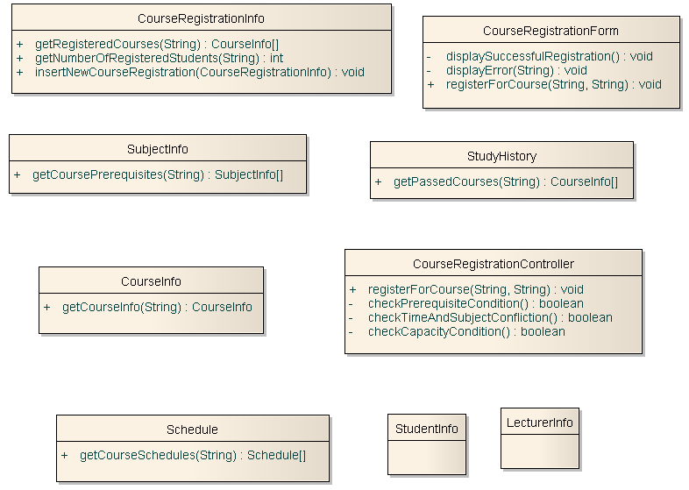

Slide 13
Nội dung
Xác định các thao tác (Operation)
Xác định phương thức (Method)
Xác định các liên kết (Association)
Xác định các thuộc tính (Attribute)
Xác định phụ thuộc (Dependency)
Xác định tổng quát hóa (Generalization)

Slide 14
2. Xác định phương thức
Phương thức (method) là gì?
  Mô tả sự thực thi của thao tác (operation)
Mục đích
  Xác định các vấn đề riêng cho việc thực thi thao tác
Các vấn đề cần xem xét:
  Các thuật toán đặc biệt
  Các đối tượng hoặc các thao tác khác cần sử dụng
  Các thuộc tính và các tham số sẽ được thực thi và sử dụng
  Các mối quan hệ sẽ được thực thi và sử dụng
Notes:
Operations define the signature for the behavior, while the method defines the implementation.
A method specifies the implementation of an operation. It describes how the operation works, not just what it does.
The method, if described, should discuss:
How operations are to be implemented.
How attributes are to be implemented and used to implement operations.
How relationships are to be implemented and used to implement operations.
The requirements will naturally vary from case to case. However, the method specifications for a class should always state:
What is to be done according to the requirements.
What other objects and operations are to be used.
More specific requirements may concern:
How parameters are to be implemented.
Any special algorithms to be used.
In many cases, where the behavior required by the operation is sufficiently defined by the operation name, description and parameters, the methods are implemented directly in the programming language. Where the implementation of an operation requires use of a specific algorithm, or requires more information than is presented in the operation's description, a separate method description is required.

Slide 15
Nội dung
Xác định các thao tác (Operation)
Xác định phương thức (Method)
Xác định các liên kết (Association)
Xác định các thuộc tính (Attribute)
Xác định phụ thuộc (Dependency)
Xác định tổng quát hóa (Generalization)

Slide 16

3. Xác định các liên kết
Mục đích
  Tinh chỉnh các kết hợp còn lại
Các vấn đề cần xem xét:
  Association vs. Aggregation
  Aggregation vs. Composition
  Attribute vs. Association
  Navigability
  Multiplicity design
Notes:
At this point, we have identified which class relationships should be dependencies. Now it is time to design the details of the remaining associations.
Also, additional associations may need to be defined to support the method descriptions defined earlier. Remember, to communicate between their instances, classes must have relationships with each other.
We will discuss each of the “things to look for” topics on subsequent slides, except for “Association vs. Aggregation,” which was discussed in the Use-Case Analysis module.

Slide 17
Composition là gì?
Một dạng của aggregation với quyền sở hữu mạnh và các vòng đời trùng khớp.
  Whole sở hữu Part, tạo và hủy Part.
  Part bị bỏ đi khi Whole bị bỏ, Part không thể tồn tại nếu Whole không tồn tại.
Whole
Part
Whole
Part
Composition
Notes:
Compositional aggregation can be shown by nesting one class within another. Composition is not equivalent to containment by value, as some languages do not support containment by value (for example, Java). By value versus by reference is an implementation “thing,” whereas composition is a conceptual “thing” that can be realized in the implementation using by-value, or by-reference (if the distinction is supported).
Composition is a form of aggregation with strong ownership and coincident lifetimes of the part with the aggregate. The whole “owns” the part and is responsible for the creation and destruction of the part. The part is removed when the whole is removed. The part may be removed (by the whole) before the whole is removed.
A solid filled diamond is attached to the end of an association path (on the “whole side”) to indicate composition.
In some cases, composition can be identified as early as Analysis, but more often it is not until Design that such decisions can be made confidently. That is why composition is introduced here rather than in Use-Case Analysis.

Slide 18
Aggregation: Shared vs. Non-shared
Shared Aggregation
Non-shared Aggregation
Multiplicity > 1
Whole
1..*
0..*
Part
Multiplicity = 1
Multiplicity = 1
Whole
1
0..*
Part
Whole
1
0..*
Part
Composition
By definition, composition is non-shared aggregation.
Notes:
A multiplicity of “0” (that is, “0..0”) on the aggregate/whole side is not allowed (it would mean that the association could never exist). The UML does not preclude it, but it makes no sense, so for practical reasons, the Rational Unified Process does not allow it.
0..1 and 0..* can be used to specify optionality, but on the “parts” of an aggregation only. Remember, the definition of aggregation is that the part does not make sense outside the context of the whole, so having a multiplicity including 0 would make no sense (you could have a part without the whole).
Another example of shared aggregation is an engine. A specific engine may be part of many different elements (cars, boats, planes) in it is lifetime.
For composition, the multiplicity of the aggregate end may not exceed one (it is unshared). The aggregation is also unchangeable; that is, once established its links cannot be changed. Parts with multiplicity having a lower bound of 0 can be created after the aggregate itself, but once created, they live and die with it. Such parts can also be explicitly removed before the death of the aggregate.
Non-shared aggregation does not necessarily imply composition.
An aggregation relationship that has a multiplicity greater than one established for the aggregate is called “shared,” and destroying the aggregate does not necessarily destroy the parts. By implication, a shared aggregation forms a graph, or a tree with many roots.
An example of shared aggregation may be between a University class and a Student class (the University being the “whole” and the Students being the “parts”). With regards to registration, a Student does not make sense outside the context of a University, but a Student may be enrolled in classes in multiple Universities.

Slide 19
Aggregation hay Composition?
Xem xét vòng đời của Class1 và Class2
Class1
Class2
Aggregation
Class1
Class2
Composition
Notes:
The use of association versus aggregation was discussed in the Use-Case Analysis module. Here we discuss the use of “vanilla” aggregation versus composition.
Composition should be used over "plain" aggregation when there is a strong interdependency between the aggregate and the parts, where the definition of the aggregate is incomplete without the parts. For example, it does not make sense to have an Order if there is nothing being ordered.
Composition should be used when the whole and part must have coincident lifetimes. Selection of aggregation or composition will determine how object creation and deletion are designed.

Slide 20
Ví dụ: Composition
CourseInfo
1
Schedule
0..*
CourseRegistrationForm
1
CourseRegistrationController
1
Notes:
This slide demonstrates two examples of composition.
The top graphic demonstrates how a previous aggregation relationship has been refined into a composition relationship.The relationship from Student to Schedule is modeled as a composition because if you got rid of the Student, you would get rid of any Schedules for that Student.
The bottom graphic demonstrates how a previous association relationship has been refined into a composition relationship. It was decided that an instance of a RegistrationController would NEVER exist outside the context of a particular Register For Courses Student session. Thus, since the RegisterForCoursesForm represents a particular Register For Courses session, a RegistrationController would NEVER exist outside of the context of a particular RegisterForCoursesForm. When a MaintainScheduleForm is created, an instance of RegistrationController should always be created. When MaintainScheduleForm is deleted, the instance of the RegistrationController should always be deleted. Thus, because they now have coincident lifetimes, composition is used instead of an association.

Slide 21
Attributes và Composition
Sử dụng composition khi:
  Các đặc tính (property) cần định danh độc lập
  Nhiều lớp có cùng các đặc tính
  Các đặc tính có một cấu trúc phức tạp và các đặc tính của riêng chúng
  Các đặc tính phải có hành vi phức tạp của riêng chúng
  Các đặc tính có mối quan hệ của riêng chúng
Còn lại sử dụng thuộc tính (attribute)
Notes:
Composition and attributes are semantically equivalent. It just depends on what you need to model to make your system understandable.
Classes are capable of expressing structure, relationships, and more complex behavior. If you need any of these, use a class.
Attributes cannot have structure; they are simple values, usually instances of primitive data types. If you don’t need structure, use an attribute. If you don’t need to do more than get or set the value of something, use an attribute.
From the UML:
“A data type is a type whose values have no identity, i.e. they are pure values. Data types include primitive built-in types (such as integer and string) as well as enumeration types”.
A property of a class is something that the class knows about. You can model a class property as a class (with a composition relationship), or as a set of attributes of the class. In other words, you can use composition to model an attribute.
The decision whether to use a class and composition, or a set of attributes, depends on the following:
Do the properties need to have independent identity, such that they can be referenced from a number of objects? If so, use a class and composition.
Do a number of classes need to have the same properties? If so, use a class and composition.
Do the properties have a complex structure, properties, and behavior of their own? If so, use a class (or classes) and composition.
Otherwise, use attributes.
The decision of whether to use attributes or a composition association to a separate class may also be determined based on the degree of coupling between the concepts being represented. When the concepts being modeled are tightly connected, use attributes. When the concepts are likely to change independently, use composition.

Slide 22
Điều hướng (Navigability) là gì?
Điều hướng từ một lớp kết hợp đến lớp đích sử dụng association.
<<Control>>
CourseRegistrationController
CourseInfo
Notes:
The navigability property on a role indicates that it is possible to navigate from an associating class to the target class using the association. This may be implemented in a number of ways: by direct object references, by associative arrays, hash-tables, or any other implementation technique that allows one object to reference another.
Navigability is indicated by an open arrow placed on the target end of the association line next to the target class (the one being navigated to). The default value of the navigability property is true (associations are bi-directional by default).
In the course registration example, the association between the Schedule and the Course Offering is navigable in both directions. That is, a Schedule must know the Course Offering assigned to the Schedule and the Course Offering must know the Schedules it has been placed in.
When no arrowheads are shown, the association is assumed to be navigable in both directions.
In the case of the associations between Schedule and Registration Controller, the Registration Controller must know its Schedules, but the Schedules have no knowledge of the Registration Controllers (or other classes, since many things have addresses) associated with the address. As a result, the navigability property of the Registration Controller end of the association is turned off.
This slide was first introduced in Concepts of Object Orientation.

Slide 23
Navigability: Hướng nào thực sự cần?
Xem xét các biểu đồ tương tác
Thậm chí khi cả hai hướng đều có vẻ cần nhưng một hướng lại vẫn hoạt động tốt
  Navigability theo 1 hướng ít xảy ra
  Số lượng thể hiện của một lớp là nhỏ
Schedule
+ primaryCourses
CourseInfo
0..*
0..4
?
Schedule
+ primaryCourses
CourseInfo
Schedule
+ primaryCourses
CourseInfo
0..*
0..4
0..*
0..4
Notes:
Review the basic definition of navigability with the students:
The navigability property on a role indicates that it is possible to navigate from an associating class to the target class using the association.
Because navigability is true by default, you only need to find associations (and aggregations) where all opposite link roles of all objects of a class in the association do not require navigability. In those cases, set the navigability to False on the class‘s role.
This is not always as straightforward as it may seem. We’ll take a look at this in more detail on subsequent slides.
During Use-Case Analysis, associations (and aggregations) may have been assumed to be bi-directional (that is, communication may occur in both directions).
During Class Design, the association’s navigability needs to be refined so that only the required communication gets implemented.
Navigation is readdressed in Class Design because we now understand the responsibilities and collaborations of the classes better than we did in Use-Case Analysis. We also want to refine the relationships between classes.Two-way relationships are more difficult and expensive to implement than one-way relationships. Thus, one of the goals in Class Design is the reduction of two-way (bi-directional) relationships into one-way (unidirectional) relationships.
The need for navigation is revealed by the use cases and scenarios. The navigability defined in the class model must support the message structure designed in the interaction diagrams.
In some circumstances even if two-way navigation is required, a one-way association may suffice. For example, you can use one-way association if navigation in one of the directions is very infrequent and does not have stringent performance requirements, or the number of instances of one of the classes is very small.

Slide 24
Ví dụ: Tinh chỉnh điều hướng
Total number of Schedule is small, or
Never need a list of the Schedule on which the CourseInfo appears
Total number of CourseInfo is small, or
Never need a list of CourseInfo on a Schedule
Total number of CourseInfo and Schedule are not small
Must be able to navigate in both directions
Schedule
+ primaryCourses
CourseInfo
0..*
0..4
Schedule
+ primaryCourses
CourseInfo
0..*
0..4
Schedule
+ primaryCourses
CourseInfo
0..*
0..4
Notes:
This example is somewhat contrived, since having a small number of students or a small number of CourseOfferings is probably unlikely for a real-life registration system, but you get the point.
In Situation 1: Implement only the Schedule-to-CourseOffering direction. If navigation is required in the other direction (that is, if a list of Schedules on which the CourseOffering appears is needed), it is implemented by searching all of the Schedule instances and checking the CourseOfferings that appear on them.
In Situation 2: Implement only the CourseOffering-to-Schedule direction. If navigation is required in the other direction (that is, if a list of CourseOfferings on a Schedule is needed), it is implemented by searching all of the CourseOffering instances and checking the Schedules on which they appear.
For the example in this course, the first option (navigation from Schedule to the Primary CourseOfferings) was chosen.
Note: This navigation decision holds true for the navigability from Schedule to the alternate CourseOfferings, as well.

Slide 25
Example: Association Class Design
0..*
+ alternateCourses
0..2
Schedule
CourseInfo
0..*
+ primaryCourses
0..4
PrimaryScheduleOfferingInfo
- grade
+ // is enrolled in? ()
+ // mark as enrolled in ()
+ // mark as committed ()
Design Decisions
Schedule
0..*
+ alternateCourses
0..2
CourseInfo
1
1
0..4
- theCourseOffering
0..*
- primaryCourseOfferingInfo
PrimaryScheduleOfferingInfo
- grade
+ // is enrolled in? ()
+ // mark as enrolled in ()
+ // mark as committed ()
Notes:
If there are attributes on the association itself (represented by "association classes"), create a design class to represent the “association class,” with the appropriate attributes. Interpose this class between the other two classes, and by establishing associations with appropriate multiplicity between the association class and the other two classes.
The above example demonstrates how an association class can be further designed.
When defining the navigability between the resulting classes, it was decided not to provide navigation directly to CourseOffering from Schedule (must go through PrimaryScheduleOfferingInfo).
Note: Association class design needs to be done only if the implementation does not directly support association classes and an exact visual model of the implementation is required. The above example is hypothetical. It is not included in the Course Registration Model provided with the course since the additional design details because only complicated the Design Model.

Slide 26
Thiết kế bội số quan hệ
Multiplicity = 1, hoặc Multiplicity = 0..1
  Có thể được thực hiện trực tiếp bằng một giá trị đơn hoặc con trỏ
  Không cần thiết kế thêm
Multiplicity > 1
  Không thể sử dụng giá trị đơn hoặc con trỏ
  Cần thiết kế thêm nữa
LecturerInfo
0..1
0..1
CourseInfo
+ Instructor
Cần một cho CourseInfo
LecturerInfo
0..1
0..*
CourseInfo
+ Instructor
Notes:
Multiplicity is the number of instances that participate in an association. Initial estimates of multiplicity made during analysis must be updated and refined during design.
All association and aggregation relationships must have multiplicity specified.
For associations with a multiplicity of 1 or 0..1, further design is not usually required, as the relationship can be implemented as a simple value or a pointer.
For associations with a multiplicity upper bound that is greater than 1, additional decisions need to be made. This is usually designed using “container” classes. A container class is a class whose instances are collections of other objects. Common container classes include sets, lists, dictionaries, stacks, and queues.

Slide 27
Multiplicity Design: Optionality
If a link is optional, make sure to include an operation to test for the existence of the link
LecturerInfo
0..1
CourseInfo
0..*
Notes:
If a link is optional, an operation to test for the existence of the link should be added to the class.
For example, if a Professor can be on sabbatical, a suitable operation should be included in the Professor class to test for the existence of the CourseOffering link.

Slide 28
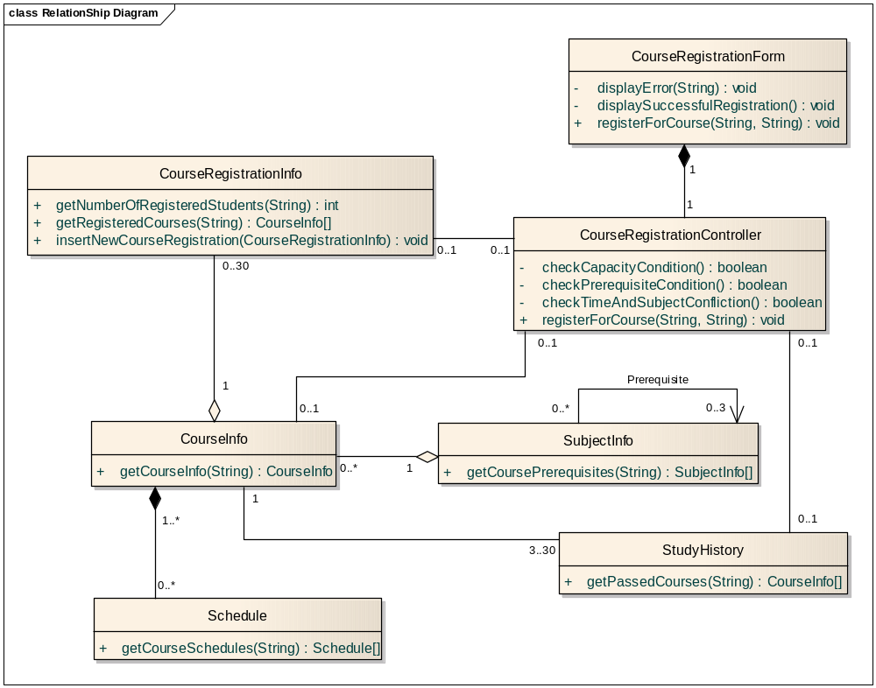

Slide 29
Chương 5. Thiết kế lớp
Xác định các thao tác (Operation)
Xác định phương thức (Method)
Xác định các liên kết (Association)
Xác định các thuộc tính (Attribute)
Xác định phụ thuộc (Dependency)
Xác định tổng quát hóa (Generalization)

Slide 30
4. Xác định các thuộc tính
Xem xét các mô tả phương thức
Xem xét các trạng thái
Xem xét bất kỳ thông tin nào mà lớp đó cần lưu giữ, duy trì.
Notes:
Attributes the class needs to carry out its operations and the states of the class are identified during the definition of methods. Attributes provide information storage for the class instance and are often used to represent the state of the class instance. Any information the class itself maintains is done through its attributes.
You may need to add additional attributes to support the implementation and establish any new relationships that the attributes require.
Check to make sure all attributes are needed. Attributes should be justified — it is easy for attributes to be added early in the process and survive long after they are no longer needed due to shortsightedness. Extra attributes, multiplied by thousands or millions of instances, can have a large effect on the performance and storage requirements of the system.

Slide 31
Biểu diễn các thuộc tính
Chỉ ra tên, kiểu và giá trị mặc định nếu có
  attributeName : Type = Default
Tuân theo quy ước đặt tên của ngôn ngữ cài đặt và của dự án.
Kiểu (type) nên là kiểu dữ liệu cơ bản trong ngôn ngữ thực thi
  Kiểu dữ liệu có sẵn, kiểu dữ liệu người dùng định nghĩa, hoặc lớp tự định nghĩa.
Xác định phạm vi truy cập
  Public: +
  Private: -
  Protected: #
Notes:
In analysis, it was sufficient to specify the attribute name only, unless the representation was a requirement that was to constrain the designer.
During Design, for each attribute, define the following:
Its name, which should follow the naming conventions of both the implementation language and the project.
Its type, which will be an elementary data type supported by the implementation language.
Its default or initial value, to which it is initialized when new instances of the class are created.
Its visibility, which will take one of the following values:
Public: The attribute is visible both inside and outside the package containing the class.
Protected: The attribute is visible only to the class itself, to its subclasses, or to friends of the class (language dependent)
Private: The attribute is visible only to the class itself and to friends of the class.
For persistent classes, also include whether the attribute is persistent (the default) or transient. Even though the class itself may be persistent, not all attributes of the class need to be persistent.
The use of attributes versus composition will be discussed later in this module.

Slide 32

Các thuộc tính dẫn xuất (derived)
Thuộc tính dẫn xuất là gì?
  Là thuộc tính có giá trị có thể được tính toán dựa trên các thuộc tính khác.
Khi nào thì sử dụng?
  Khi không đủ thời gian để tính toán lại giá trị mỗi khi cần
  Khi bạn phải cân đối giữa hiệu năng thời gian chạy với bộ nhớ yêu cầu.
Notes:
Derived attributes and derived operations are not explicitly defined as part of the UML.
An example of a derived attribute is a class, Person, with a derived attribute, Age.
Derived attributes and operations indicate a constraint between values. They can be used to describe a dependency between attribute values that must be maintained by the class. They do not necessarily mean that the attribute value is always calculated from the other attributes.

Slide 33
Ví dụ: Define Attributes
<< interface >>
RegistrationController
ICourseCatalogSystem
0..1
0..1
0..1
+ currentSchedule
Schedule
0..1
+ registrant
- semester : Semester
0..*
1
0..*
0..*
Student
name
address
nextAvailID : int
studentID : int
dateOfBirth : Date
0..2
0..4
+ alternateCourses
+ primaryCourses
CourseOffering
number : String = “100”
startTime : Time
endTime : Time
day : String
/numStudents : int = ()
Notes:
The above example is a portion of the VOPC for the Register for Courses Use-Case Realization. It is the same diagram that was provided earlier in the Define Operations section, except now the operation compartment has been suppressed.
Notice the <<class >> attribute.
In this example, all attributes are private (marked with a “-”) to support encapsulation.
The number of students currently enrolled in the CourseOffering is represented by the derived attribute, numStudents, which has a default value of 0.
Semester, Time, and Date are included as the type for some of the attributes. For the Course Registration System, they are considered to be abstract data types that have no significant behavior and thus are not modeled as separate classes.
Remember, there is not a direct relationship between Student and CourseOffering.
Thus, the value of numStudents equals the number of links that exist from a CourseOffering instance to Schedule instances.
You don’t have to share this thought with the students if you think it will confuse them.

Slide 34
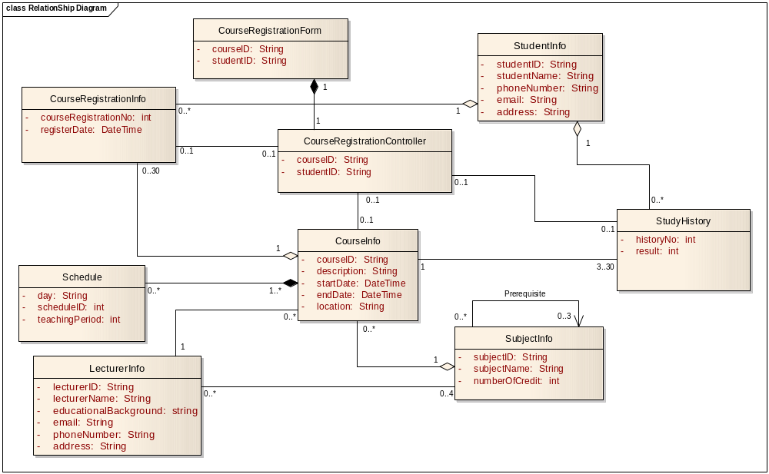

Slide 35
Nội dung
Xác định các thao tác (Operation)
Xác định phương thức (Method)
Xác định các liên kết (Association)
Xác định các thuộc tính (Attribute)
Xác định phụ thuộc (Dependency)
Xác định tổng quát hóa (Generalization)

Slide 36
5. Xác định phụ thuộc (Dependency)
Một phụ thuộc là gì?
  Là mối quan hệ ngữ nghĩa giữa hai đối tượng, trong đó một sự thay đổi trong supplier có thể gây ra thay đổi cho client.
Mục đích
  Xác định khi các mối quan hệ cấu trúc (association hoặc aggregation) không cần đến.
Cần xem xét:
  Cái gì làm cho supplier có thể được nhìn thấy client?
Client
Supplier
Notes:
During Analysis, we assumed that all relationships were structural (associations or aggregations). In Design, we must decide what type of communication pathway is required.
A dependency relationship denotes a semantic relationship between model elements, where a change in the supplier may cause a change in the client.

Slide 37
Liên kết và Phụ thuộc
Kết hợp là mối quan hệ cấu trúc
Phụ thuộc là mối quan hệ phi-cấu trúc
Để các đối tượng có thể “biết lẫn nhau”, chúng phải được nhìn thấy
  Local variable reference
  Parameter reference
  Global reference
  Field reference
Supplier2
Client
Dependency
Association
Supplier1
Notes:
There are four options for creating a communication pathway to a supplier object:
Global: The supplier object is a global object.
Parameter: The supplier object is a parameter to, or the return class of, an operation in the client object.
Local: The supplier object is declared locally (that is, created temporarily during execution of an operation).
Field: The supplier object is a data member in the client object.
A dependency is a type of communication pathway that is a transient type of relationship.These occur when the visibility is global, parameter, or local.
Look at each association relationship and determine whether it should remain an association or become a dependency. Associations and aggregations are structural relationships (field visibility). Association relationships are realized by variables that exist in the data member section of the class definition. Any other relationships (global, local, and parameter visibility) are dependency relationships.

Slide 38
Kết hợp và Phụ thuộc
Một thể hiện của một kết hợp là một liên kết
  Tất cả các liên kết đều trở thành kết hợp trừ khi chúng có phạm vi truy cập là toàn cục, cục bộ hoặc tham số.
  Các mối quan hệ phụ thuộc vào ngữ cảnh
Phụ thuộc là các liên kết tạm thời với:
  Một khoảng thời gian giới hạn
  Một mối quan hệ độc lập với ngữ cảnh
  Một mối quan hệ tổng hợp
A dependency is a secondary type of relationship in that it doesn't tell
you much about the relationship. For details you need to consult the
collaborations.
Notes:
According to the UML 2 Specification, a link is an instance of an association. Specifically, an association declares a connection (link) between instances of the associated classifiers (classes). A dependency relationship indicates that the implementation or functioning of one or more elements requires the presence of one or more other elements.
Note that links modeled as parameter, global, or local are transient links. They exist only for a limited duration and in the specific context of the collaboration; in that sense, they are instances of the association role in the collaboration. However, the relationship in a class model (independent of context) should be, as stated above, a dependency. In The UML Reference Manual, the definition of a transient link is: "It is possible to model all such links as associations, but then the conditions on the associations must be stated very broadly, and they lose much of their precision in constraining combinations of objects." In this situation, the modeling of a dependency is less important than the modeling of the relationship in the collaboration, because the dependency does not describe the relationship completely, only that it exists.
If you believe that a link in a collaboration is a transient link, it indicates that the context-independent relationship between the classes is a dependency. Dependency is a “summary” relationship — for details you have to consult the behavioral model.
Context is defined as "a view of a set of related modeling elements for a particular purpose."
These guidelines should help to remove some of the mystery of determining if a relationship is a dependency or an association.
Emphasize that the designer needs to go back to the communication diagram to determine if the link is a dependency or not.

Slide 39
Phạm vi biến địa phương
Thao tác op1() chứa một biến địa phương của ClassB
ClassA
+ op1 ( )
ClassB
Notes:
Is the receiver a temporary object created and destroyed during the operation itself? If so, establish a dependency between the sender and receiver classes in a class diagram containing the two classes.
The key thing here is that the designer look at the Communication diagram to determine if the relationship is a dependency. If the link is transient then a dependency should be created instead of an association.
The Communication diagrams refine the link visibility adornments.

Slide 40
Phạm vi tham số
Thể hiện của ClassB được truyền tham số đến thể hiện của ClassA.
ClassA
+ op1 ( [in] aParam : ClassB )
ClassB
Notes:
Is the reference to the receiver passed as a parameter to the operation? If so, establish a dependency between the sender and receiver classes in a Class diagram containing the two classes.

Slide 41
Phạm vi toàn cục
Thể hiện ClassUtility có thể nhìn thấy vì nó là toàn cục
ClassA
+ op1 ( )
ClassB
+ utilityOp ( )
Notes:
Is the receiver a “global?” If so, establish a dependency between the sender and receiver classes in a class diagram containing the two classes.

Slide 42
Xác định các phụ thuộc
Các mối quan hệ lâu dài – Association (field visibility)
Các mối quan hệ tạm thời — Dependency
  Nhiều đối tượng chia sẻ cùng một thể hiện
    Truyền thể hiện như một tham số (parameter visibility)
    Làm cho thể hiện có phạm vi toàn cục có kiểm soát (global visibility)
  Nhiều đối tượng không chia sẻ cùng một thể hiện (local visibility)
Notes:
If it is going to be a parameter visibility, you have to look back up the food chain to see where the class passing it as a parameter got it. For example, maybe it is used on some entity class as a parameter, but is a field on the controller.
Strive for real-world relationships. Semantic, structural relationships should be associations.
Strive for the lightest relationships possible. Dependency is the cheapest to keep, easiest to use, and benefits from encapsulation.
Is the relationship transient? Will you need this relationship again and again, or do you just need it to do some work and then throw it away? If its needed again and again, that is, if a thing appears to remain related to another thing even across the execution of one or more operations, then it is likely an association and should benefit from field visibility. Otherwise, the relationship may be transient and can have local, parameter, or global visibility.
Is the same instance shared across objects? If many objects at runtime need it again and again and they share the same instance, maybe you should pass it around as a parameter. If there is only one instance in existence in the whole process, set it up as a managed global (for example, Singleton design pattern). If the same instance is not shared, then having a local copy will suffice (local visibility).
How long does the instance take to create and destroy? Is it expensive to connect and disconnect every time you need it? If so, you would want to give the object field, parameter, or global visibility.

Slide 43
Ví dụ: Define Dependencies (before)
RegistrationController
<<interface>>
ICourseCatalogSystem
0..*
1
+ // submit schedule ()
+ courseCatalog
+ getCourseOfferings ( [in] forSemester : Semester) : CourseOfferingList
+ // save schedule ()
+ // create schedule with offerings ()
+ // get course offerings ()
0..1
Schedule
0..1
- semester : Semester
0..1
+ submit ()
+ currentSchedule
+ //save ()
# any conflicts? ()
+ //create with offerings()
0..*
0..*
0..*
0..1
+ registrant
1
alternateCourses
+ primaryCourses
Student
0..2
0..4
- name
CourseOffering
- address
- number : String = "100"
- StudentID : int
- startTime : Time
+ addSchedule ( [in] aSchedule : Schedule )
- endTime : Time
+ getSchedule ( [in] forSemester : Semester ) : Schedule
- day : String
+ hasPrerequisites ( [in] forCourseOffering : CourseOffering ) : boolean
+ addStudent ( [in] aStudentSchedule : Schedule)
# passed ( [in] aCourseOffering : CourseOffering ) : boolean
+ removeStudent ( [in] aStudentSchedule : Schedule)
+ new ()
+ setData ()
Notes:
This class diagram is a subset of the View of Participating Classes (VOPC) from the Register for Courses use case.
Up to this point, most of the relationships that we have defined have been associations (and aggregations). Now we will see how some of these associations/aggregations are refined into dependencies.
The dependency shown above from Schedule to CourseOffering was previously defined in the Define Operations section to support the Schedule operation signatures.
Note: All association/aggregation relationships should be examined to see if they should be dependencies. We have just chosen to work with a VOPC subset for this example.

Slide 44
Ví dụ: Define Dependencies (after)
RegistrationController
<<interface>>
ICourseCatalogSystem
+ // submit schedule ()
+ getCourseOfferings ( [in] forSemester : Semester) : CourseOfferingList
+ // save schedule ()
Global visibility
+ // create schedule with offerings ()
+ // get course offerings ()
0..1
Schedule
0..1
- semester : Semester
0..1
+ submit ()
Field visibility
+ currentSchedule
+ //save ()
Field
visibility
# any conflicts? ()
+ //create with offerings()
0..*
0..*
0..*
0..1
+ registrant
1
alternateCourses
+ primaryCourses
Student
0..2
0..4
- name
CourseOffering
- address
- number : String = "100"
- StudentID : int
- startTime : Time
+ addSchedule ( [in] aSchedule : Schedule )
- endTime : Time
+ getSchedule ( [in] forSemester : Semester ) : Schedule
- day : String
+ hasPrerequisites ( [in] forCourseOffering : CourseOffering ) : boolean
+ addStudent ( [in] aStudentSchedule : Schedule)
# passed ( [in] aCourseOffering : CourseOffering ) : boolean
+ removeStudent ( [in] aStudentSchedule : Schedule)
Parameter visibility
+ new ()
+ setData ()
Notes:
If the students would like an example of global visibility, tell them that all relationships to the Java RMI Naming class would be a good example.
On the presented slide, the changes made are shown in blue, but this does not show up in the black-and-white manuals.
This example demonstrates how an association on the class diagram provided on the previous slide has been refined into a dependency relationship.
During a registration session, the RegistrationController works with one Student, the registrant (the Student that is registering), and one Schedule, the current Schedule (the Student’s Schedule for the current semester). These instances need to be accessed by more than one of the RegistrationController’s operations, so field visibility is chosen from RegistrationController to Student and from RegistrationController to Schedule. Thus, the relationships remain associations.
A Student manages its own Schedules, so field visibility is chosen from Student to Schedule and the relationship remains an aggregation.
CourseOfferings are part of the semantics of what defines a Schedule (a Schedule is the courses a that a Student has selected for a semester). Thus, field visibility is chosen from Schedule to CourseOffering and the relationships remain associations.
The Student class has several operations where CourseOffering appears in the parameter list. Thus, parameter visibility is chosen from Student to CourseOffering. This relationship was actually defined earlier in the Define Operations section.
It is envisioned that the course Catalog System may need to be accessed by multiple clients in the system, so global visibility was chosen, and the relationship becomes a dependency. This is the only change that was made to the relationships shown on the previous slide.

Slide 45
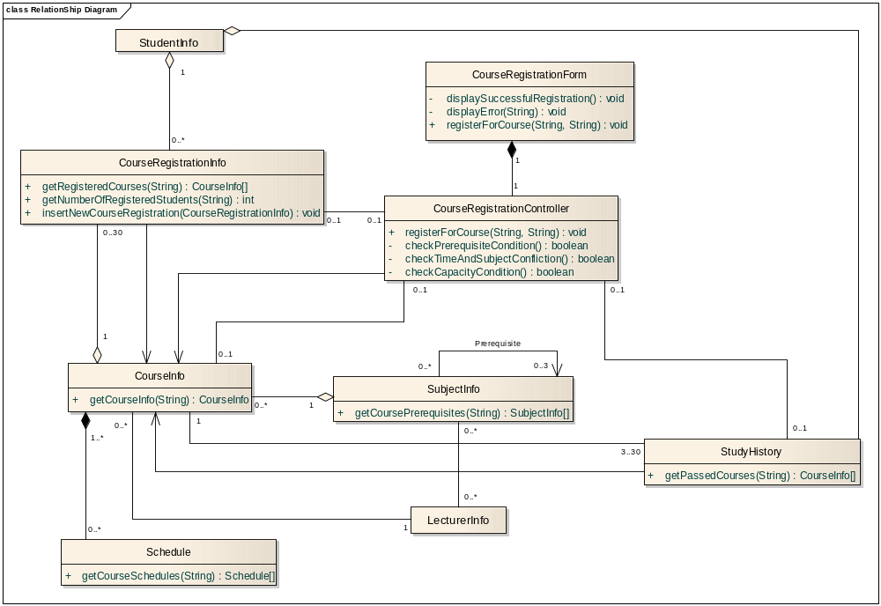

Slide 46
Nội dung
Xác định các thao tác (Operation)
Xác định phương thức (Method)
Xác định các liên kết (Association)
Xác định các thuộc tính (Attribute)
Xác định phụ thuộc (Dependency)
Xác định tổng quát hóa (Generalization)

Slide 47
6. Generalization
Account
One class shares the structure and/or behavior of one or more classes
“Is a kind of” relationship
In Analysis, use sparingly
+ balance
+ name
Superclass (Parent) (Ancestor)
+ number
+ withdraw ()
+ createStatement ()
Generalization Relationship
Checking
Savings
+ getInterest ()
Subclasses (Child) (Descendants)
Notes:
As discussed in Concepts of Object Orientation, generalization is a relationship among classes where one class shares the structure and/or behavior of one or more classes. This slide is repeated here for review purposes.
Generalization refines a hierarchy of abstractions in which a sub-class inherits from one or more super-classes.
Generalization is an “is a kind of” relationship. You should always be able to say that your generalized class “is a kind of” the parent class.
The terms “ancestor” and “descendent” may be used instead of “super-class” and “sub-class”.
In Analysis, generalization should be used only to model shared behavioral semantics (that is, generalization that passes the “"is a"” test). Generalization to promote and support reuse is determined in Design. In Analysis, the generalization should be used to reflect shared definitions/semantics. This promotes “brevity of expression.” The use of generalization makes the definitions of the abstractions easier to document and understand.
When generalization is found, a common super-class is created to contain the common attributes, associations, aggregations, and operations. The common behavior is removed from the classes that are to become sub-classes of the common super-class. A generalization relationship is drawn from the sub-class to the super-class.
Emphasize what happens when a change is made to a super class – the fact that all descendent classes must inherit the change whether they want to or not.
Note: For most languages, encapsulation is violated in the generalization relationship (in C++, attributes are often protected instead of private).

Slide 48

Abstract and Concrete Classes
Abstract classes cannot have any objects
Concrete classes can have objects
Discriminator
Animal
Abstract class
+ communicate ()
Abstract operation
Communication
There are no direct instances of Animal
Lion
Tiger
+ communicate ()
+ communicate ()
All objects are either lions or tigers
Notes:
A class that exists only for other classes to inherit from it is an abstract class. Classes that are to be used to instantiate objects are concrete classes.
An operation can also be tagged as abstract. This means that no implementation exists for the operation in the class where it is specified. A class that contains at least one abstract operation must be an abstract class. Classes that inherit from an abstract class must provide implementations for the abstract operations. Otherwise, the operations are considered abstract within the subclass, and the subclass is considered abstract, as well. Concrete classes have implementations for all operations.
In the UML, you designate a class as abstract by putting the class name in italics. For abstract operations, you put the operation signature in italics. The name of the abstract item can also be shown in italics.
A discriminator can be used to indicate on what basis the generalization/specialization occurred. A discriminator describes a characteristic that differs in each of the subclasses. In the above example, we generalized/specialized in the area of communication.
An abstract class must have at least one concrete class to be useful.

Slide 49
Multiple Inheritance: Problems
Name clashes on
attributes or operations
Repeated inheritance
SomeClass
Animal
FlyingThing
+ color
+ color
+ getColor ()
+ getColor ()
Animal
FlyingThing
+ color
+ color
+ getColor ()
+ getColor ()
Bird
Bird
Resolution of these problems is implementation-dependent.
Notes:
See the language-specific appendices for examples of how the multiple inheritance problems are addressed in programming environments that support multiple inheritance.
In practice, multiple inheritance is a complex design problem and may lead to implementation difficulties.
In general, multiple inheritance causes problems if any of the multiple parents have structure or behavior that overlaps. If the class inherits from several classes, you must check how the relationships, operations, and attributes are named in the ancestors.
Specifically, there are two issues associated with multiple inheritance:
Name collisions: Both ancestors have attributes and/or operations with the same name. If the same name appears in several ancestors, you must describe what this means to the specific inheriting class, for example, by qualifying the name to indicate its source of declaration.
Repeated inheritance: The same ancestor is being inherited by a descendant more than once. When this occurs, the inheritance hierarchy will have a "diamond shape" as shown above. The descendents end up with multiple copies of an ancestor.
If you are using repeated inheritance, you must have a clear definition of its semantics; in most cases this is defined by the programming language supporting the multiple inheritance.
In general, the programming language rules governing multiple inheritance are complex, and often difficult to use correctly. Therefore, it is recommended that you use multiple inheritance only when needed and always with caution.
Note: You can use delegation as a workaround to multiple inheritance problems. Delegation is described later in this module.

Slide 50
Generalization Constraints
Complete
  End of the inheritance tree
Incomplete
  Inheritance tree may be extended
Disjoint
  Subclasses mutually exclusive
  Doesn’t support multiple inheritance
Overlapping
  Subclasses are not mutually exclusive
  Supports multiple inheritance
Notes:
No matter what constraint is used, you cannot assume that any diagram contains the complete inheritance hierarchy. Inheritance hierarchies may be elided on diagrams for clarity.
The UML defines four standard constraints for generalization relationships:
Complete: This constraint indicates the end of the inheritance hierarchy. All children in the generalization relationship have been defined in the model. No more children can be defined. The “leaves” of the inheritance hierarchy cannot be specialized any further. Use the Complete constraint to explicitly note that the generalization hierarchy has not been fully specified in the model.
Incomplete: All children in the generalization relationship have not been defined in the model. More children may be defined. The “leaves” of the inheritance hierarchy may be specialized. Use the Incomplete constraint to explicitly note that the generalization hierarchy has not been fully specified in the model.
The following two constraints only apply in the context of multiple inheritance:
Disjoint: An object of the parent cannot have more than one of the children as its type (that is, subclasses are mutually exclusive). Disjoint is used to support the modeling of static classification, where an object cannot change its type at run-time.
Overlapping: An object of the parent may have more than one of the children as its type. Overlapping is used to support the modeling of dynamic classification, where an object can change its type at run-time. It shows the potential types of an object.

Slide 51
Example: Generalization Constraints
Asset
Multiple
Inheritance
not supported
{disjoint}
Bank Account
Real Estate
Security
{disjoint,complete}
{disjoint}
Savings
Checking
Stock
Bond
End of inheritance hierarchy
Notes:
This example demonstrates the use of the Complete and Disjoint constraints:
Complete: The Savings and Checking classes cannot be specialized (a generalization relationship cannot be defined in which they are the parent). These classes (and any siblings) mark the end of the inheritance hierarchy.
Disjoint: A BankAccount object cannot be both a Savings and a Checking account (that is, no multiple inheritance where parents in the multiple inheritance are the children of BankAccount).

Slide 52


Example: Generalization Constraints (cont.)
Multiple
inheritance
supported
Vehicle
{overlapping}
LandVehicle
WaterVehicle
AmphibiousVehicle
Notes:
This example demonstrates the use of the overlapping constraint. The AmphibiousVehicle class can inherit from both LandVehicle and WaterVehicle, which both inherit from Vehicle.

Slide 53
Generalization vs. Aggregation
Generalization and aggregation are often confused
  Generalization represents an “is a” or “kind-of” relationship
  Aggregation represents a “part-of” relationship
Window
Scrollbar
WindowWithScrollbar
Is this correct?
Notes:
The key phrases “is a” and “part of” help to determine correct relationship.
With inheritance:
Keywords “is a”
One object
With Aggregation:
Keywords “part of”
Relates multiple objects
Is the above example a proper use of generalization? If not, what would be a better way to model the information that maintains generalization“ "is a"” semantics?
The answer to the question on this slide is provided on the next slide.
Discuss the answer to the question with the students, using the whiteboard to capture their suggestions. Then go to the next slide to view the answer.

Slide 54
Generalization: Share Common Properties and Behavior
Follows the “is a” style of programming
Class substitutability
Animal
List
+ communicate ()
+ insertTop ([in] item)
+ insertBottom ([in] item)
+ removeTop ()
+ removeBottom ()
+ insert ([in] item, [in] position)
Lion
Tiger
Stack
+ communicate ()
+ communicate ()
Do these classes follow the “is a” style of programming?
Notes:
The answer to the question on this slide is provided on the next slide.
Discuss the answer to the question with the students. Then go to the next slide to view the answer.
A subtype is a type of relationship expressed with inheritance. A subtype specifies that the descendent is a type of the ancestor and must follow the rules of the “is a” style of programming.
The “is a” style of programming states that the descendent "is a" type of the ancestor and can fill in for all its ancestors in any situation.
The “is a” style of programming passes the Liskov Substitution Principle, which states: “If for each object O1 of type S there is an object O2 of type T such that for all programs P defined in terms of T, the behavior of P is unchanged when O1 is substituted for O2 then S is a subtype of T.”

Slide 55
Generalization: Share Common Properties and Behavior (cont.)
Animal
List
+ communicate ()
+ insertTop ([in] item)
+ insertBottom ([in] item)
+ removeTop ()
+ removeBottom ()
+ insert ([in] item, [in] position)
Lion
Tiger
Stack
+ communicate ()
+ communicate ()
Notes:
Another good discussion is to ask the class whether a square should inherit from a rectangle or vice versa.
The classes on the left-hand side of the diagram do follow the "is a" style of programming: a Lion is an Animal and a Tiger is an animal.
The classes on the right side of the diagram do not follow the “is a” style of programming: a Stack is not a List. Stack needs some of the behavior of a List but not all of the behavior. If a method expects a List, then the operation insert(position) should be successful. If the method is passed a Stack, then the insert (position) will fail.

Slide 56
Generalization: Share Implementation: Factoring
Supports the reuse of the implementation of another class
Cannot be used if the class you want to “reuse” cannot be changed
List
SequentialContainer
+ insertTop ([in] item)
+ insertTop ([in] item)
+ insertBottom ([in] item)
+ removeTop ()
+ removeTop ()
+ removeBottom ()
+ insert ([in] item, [in] position)
List
Stack
Stack
+ insertBottom ([in] item)
+ removeBottom ()
+ insert ([in] item, [in] position)
Notes:
Factoring is useful if there are some services provided by a class that you want to leverage in the implementation of another class.
When you factor, you extract the functionality you want to reuse and inherit from the new base class.

Slide 57
Generalization Alternative: Share Implementation: Delegation
Supports the reuse of the implementation of another class
Can be used if the class you want to “reuse” cannot be changed
List
Stack
+ insertTop ([in] item)
+ insertBottom ([in] item)
+ insertBottom ([in] item)
+ removeBottom ()
+ removeTop ()
+ insert ([in] item, [in] position)
+ removeBottom ()
+ insert ([in] item, [in] position)
1
1
Stack
List
Notes:
With delegation, you use a composition relationship to “reuse” the desired functionality. All operations that require the “reused” service are “passed through” to the contained class instance.
With delegation, you lose the benefit of polymorphic behavior, but you do have a model that more clearly expresses the nature of the domain (being that it is NOT "is a").
This is commonly used by mix-ins. Implementing mix-ins with composition permits run-time binding to objects rather than compile-time binding enforced by inheritance.
Note: You can also use delegation as a workaround to multiple inheritance problems discussed earlier. Have the sub-class inherit from one of the super-classes, and then use aggregation from the subclass to access the structure and behaviors of the other classes.

Slide 58
Implementation Inheritance
List
Ancestor public operations, attributes, and relationships are NOT visible to clients of descendent class instances
Descendent class must define all access to ancestor operations, attributes, and relationships
+ insertTop ([in] item)
+ insertBottom ([in] item)
+ removeTop ()
+ removeBottom ()
<<implementation>>
Stack
+ push (item)
+ pop ()
push() and pop() can access methods of List but instances of Stack cannot
Notes:
An <<implementation>> stereotype can be used to model implementation inheritance. Implementation inheritance is where the implementation of a specific element is inherited or reused.
Implementation inheritance often leads to illogical inheritance hierarchies that are difficult to understand and to maintain. Therefore, it is recommended that you use inheritance only for implementation reuse, unless something else is recommended in using your programming language. Maintenance of this kind of reuse is usually quite tricky.
In the above example, any change in the class List can imply large changes of all classes inheriting from the class List. Be aware of this and inherit only stable classes. Inheritance will actually freeze the implementation of the class List because changes to it are too expensive.

Slide 59
Review: What Is Polymorphism?
The ability to hide many different implementations behind a single interface
Manufacturer B
Manufacturer C
Manufacturer A
OO Principle:
Encapsulation
Remote Control
Notes:
Another example of polymorphism: There is a toddler sitting in front of some blocks and a teenager sitting in front of a piano. An adult walks into the room and says, “Play.” The toddler plays with the blocks and the teenager plays the piano.
Another example: the accelerator on different cars.
Polymorphism was first introduced in the Concepts of Object Orientation module. This slide is repeated here for review purposes.
The Greek term polymorphos means “having many forms”. Every implementation of the interface must implement at least the interface. The implementation can in some cases implement more than the interface.

Slide 60
Generalization: Implement Polymorphism
Animal
+ communicate ()
Lion
Tiger
+ communicate ()
+ communicate ()
Without Polymorphism
With Polymorphism
if animal = “Lion” then
  Lion communicate
else if animal = “Tiger” then
  Tiger communicate
end
Animal communicate
Notes:
It may be helpful to discuss dynamic binding at this point; however, try not to get too bogged down in implementation language discussions.
Normally the particular method to be executed as a result of a function call is known at compile time. This is called static (or early) binding. The compiler replaces the function call with code telling the program which address to jump to in order to find that function. With polymorphism, the particular type of object for which a method is to be invoked is not known until run time. The compiler cannot provide the address at compile time. The method is selected by the program as it is running
This is known as late binding or dynamic linking.
See the language-specific appendices for how this is handled by specific programming languages.
Inheritance provides a way to implement polymorphism in cases where polymorphism is implemented the same way for a set of classes. This means that abstract base classes that simply declare inherited operations, but which have no implementations of the operations, can be replaced with interfaces. Inheritance can now be restricted to inheritance of implementations only, if desired.
Polymorphism is not generalization; generalization is one way to implement polymorphism. Polymorphism through generalization is the ability to define alternate methods for ancestor class operations in the descendent classes. This can reduce the amount of code to be written, as well as help abstract the interface to descendent classes.
Polymorphism is an advantage of inheritance realized during implementation and at run time.
Programming environments that support polymorphism use dynamic binding, meaning that the actual code to execute is determined at run time rather than compile time.

Slide 61
Polymorphism: Use of Interfaces vs. Generalization
Interfaces support implementation-independent representation of polymorphism
  Realization relationships can cross generalization hierarchies
Interfaces are pure specifications, no behavior
  Abstract base class may define attributes and associations
Interfaces are totally independent of inheritance
  Generalization is used to re-use implementations
  Interfaces are used to re-use behavioral specifications
Generalization provides a way to implement polymorphism
Notes:
There are several differences between the use of generalization (abstract base classes) and interfaces:
Interfaces allow us to define polymorphism in a declarative way, unrelated to implementation. Two elements are polymorphic with respect to a set of behaviors if they realize the same interfaces. Interfaces are orthogonal to class inheritance lineage; two different classifiers may realize the same interface but be unrelated in their class hierarchies.
Interfaces are purely specifications of behavior (a set of operation signatures). An abstract base class may define attributes and associations as well.
Interfaces are totally independent of inheritance. Generalization is employed to re-use implementations; interfaces are employed to re-use and formalize behavioral specifications
Generalization provides a way to implement polymorphism in cases where polymorphism is implemented the same way for a set of classes. The use of generalization to support polymorphism was discussed earlier in this module.
If you have a group of Java developers emphasize this page and skip over the next one.

Slide 62
Polymorphism via Generalization Design Decisions
Provide interface only to descendant classes?
  Design ancestor as an abstract class
  All methods are provided by descendent classes
Provide interface and default behavior to descendent classes?
  Design ancestor as a concrete class with a default method
  Allow polymorphic operations
Provide interface and mandatory behavior to descendent classes?
  Design ancestor as a concrete class
  Do not allow polymorphic operations
Notes:
When designing the use of generalization to support polymorphism, there are three basic decisions that must be made:
Do you want to provide a function’s interface only to descendant classes? If so, design the ancestor as an abstract class, and only design methods for the descendent classes.
Do you want to provide a function’s interface and default behavior to descendent classes? If so, design the ancestor as a concrete class with a default method, and allow descendents to redefine the method.
Do you want to provide a function’s interface and mandatory behavior to descendent classes? If so, design the ancestor as a concrete class and disallow descendents from defining their own method for the operations.
If you have a group of C++ developers emphasize this page and skip over the previous page.

Slide 63
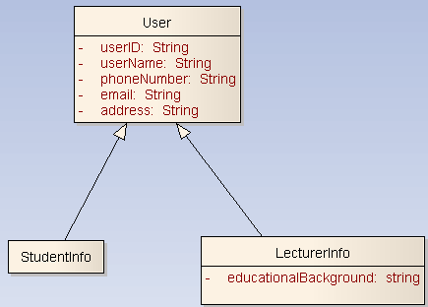
Ví dụ Generalization

Slide 64
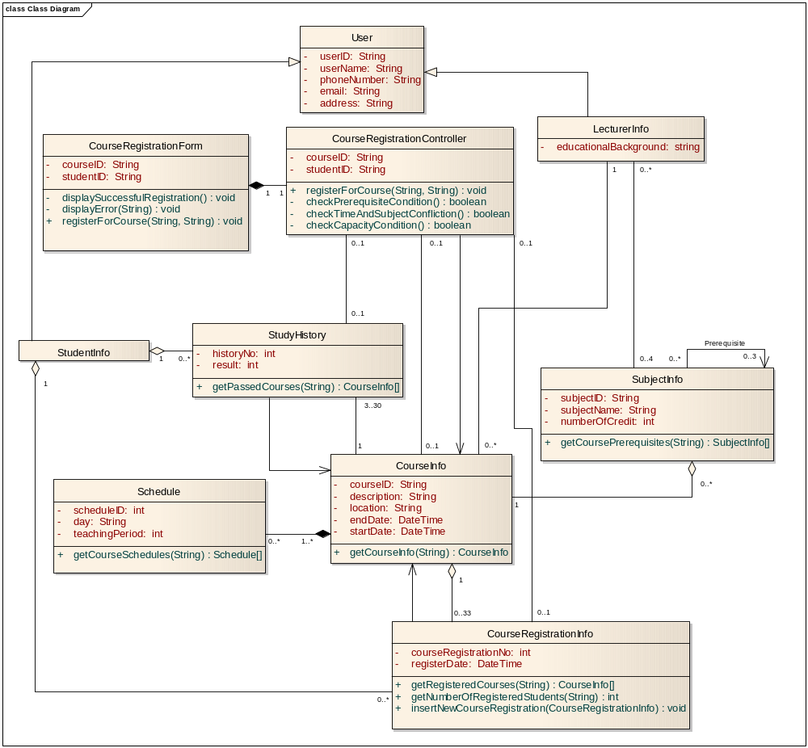
Biểu đồ lớp đầy đủ

Slide 65
Tổng kết
Các mô hình thiết kế được xây dựng trực tiếp từ các mô hình phân tích
  Là hình thức chi tiết hóa từ các lớp trừu tượng hóa trong mô hình phân tích
    Ánh xạ 1-1 cho những lớp phân tích đơn giản
  Ánhxạ thành nhiều lớp thiết kế nếu lớp phân tích đó quá phức tạp
Lớp phân tích có mức độ phức tạp cao có thể được phát triển thành hệ thống con (subsystem)
  Sử dụng các giao diện
  Đảm bảo hệ thống con có tính độc lập tối đa với các thành phần còn lại
Tìm cách sử dụng lại các hệ thống con, gói hoặc các thư viện có sẵn

